Slide 1
Studies in Frequency Domain
Name-Priya Singh Name-Aishika Das Name-Neeharika Sharma
Roll no.-2021CSB057 Roll no.-2021CSB074 Roll no.-2021CSB106

Slide 2
A. Perform frequency domain analysis for each of the implemented opamp circuits with R and/or C placed in both forward and feedback paths by giving a sweep from 10 Hz to 100 MHz. Choose component dimensions carefully and use spectrum analyzer, Bode plotter etc and also means to obtain Fourier coefficients. Try to explain the frequency domain behaviour.

Slide 3
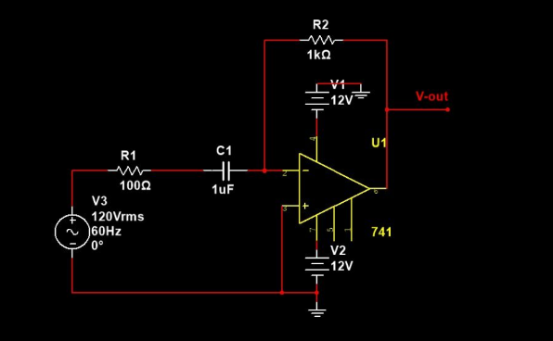
Differentiator circuit:

Slide 4
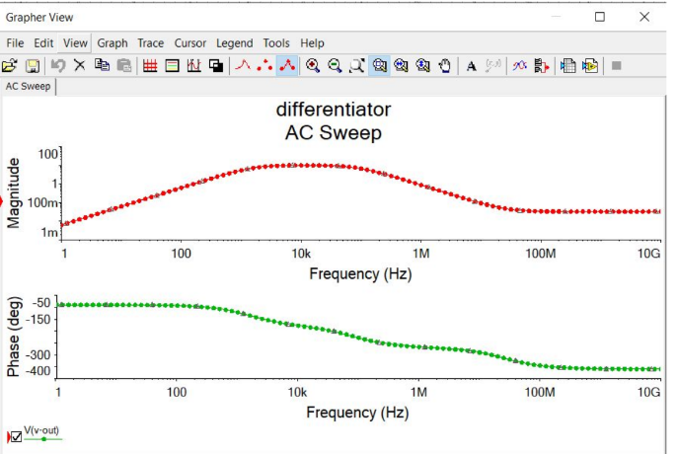
Graph:

Slide 5
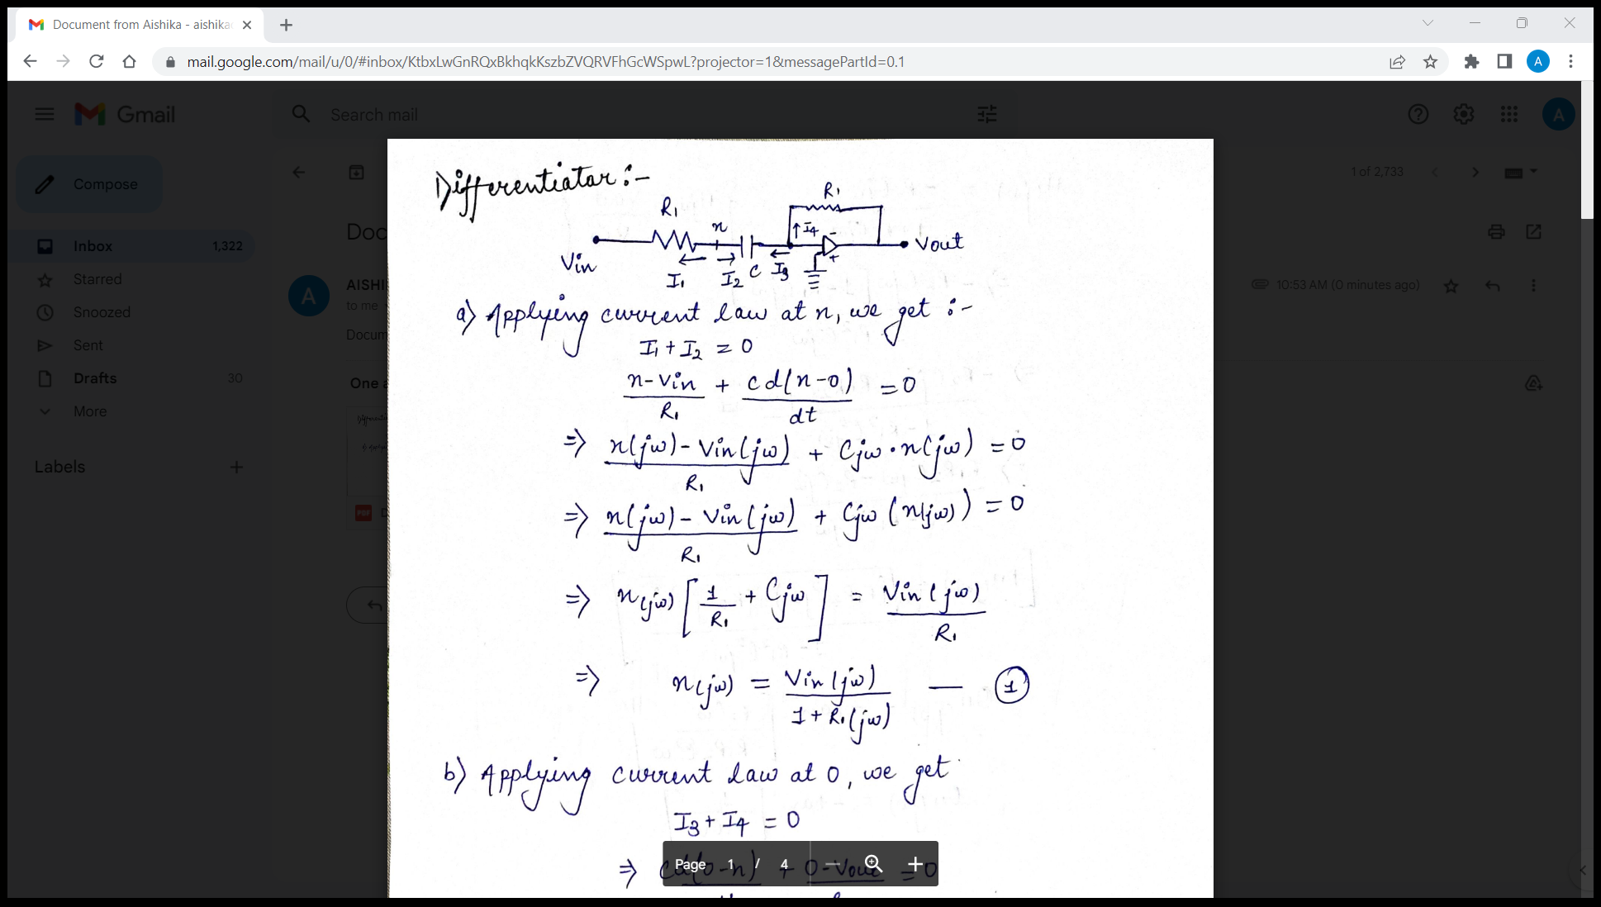
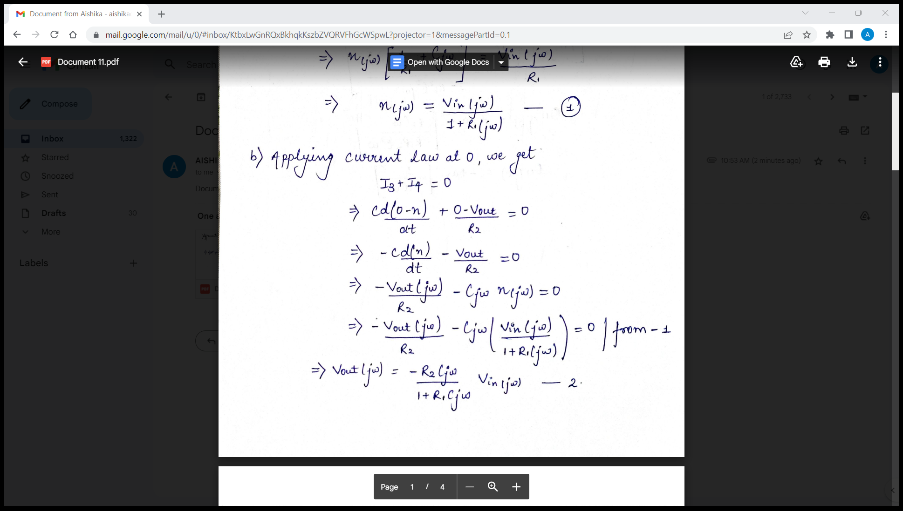
Explanation:

Slide 6
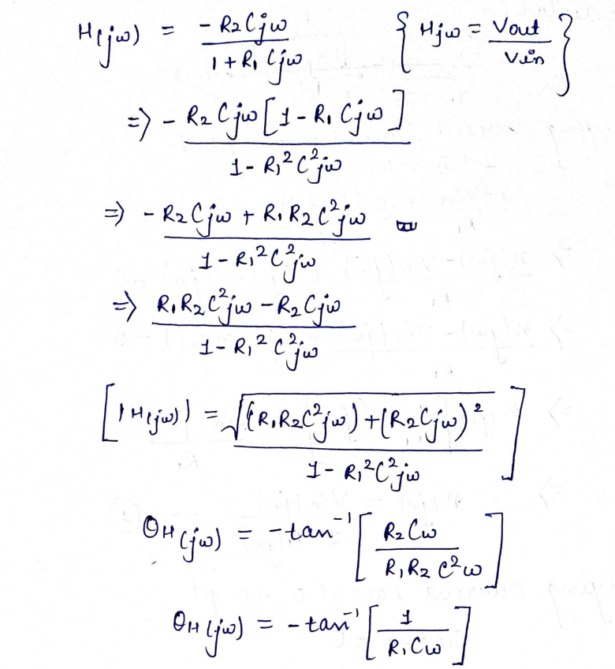

Slide 7
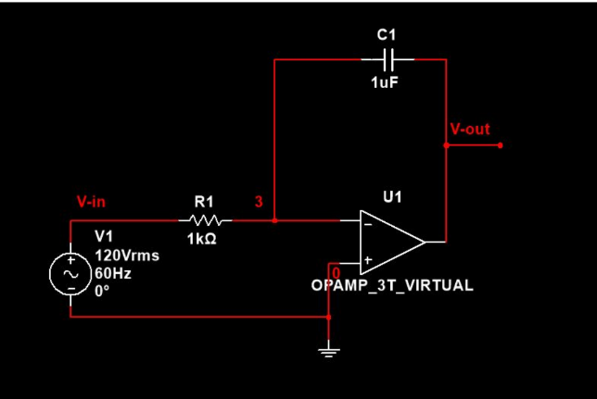
Integrator:

Slide 8
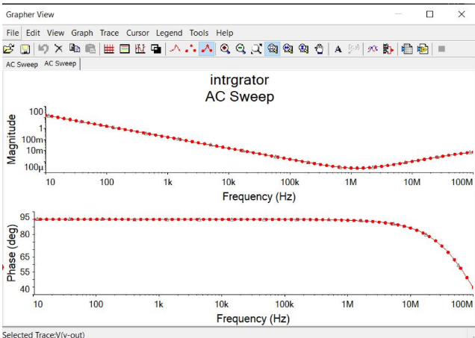
Graph:

Slide 9
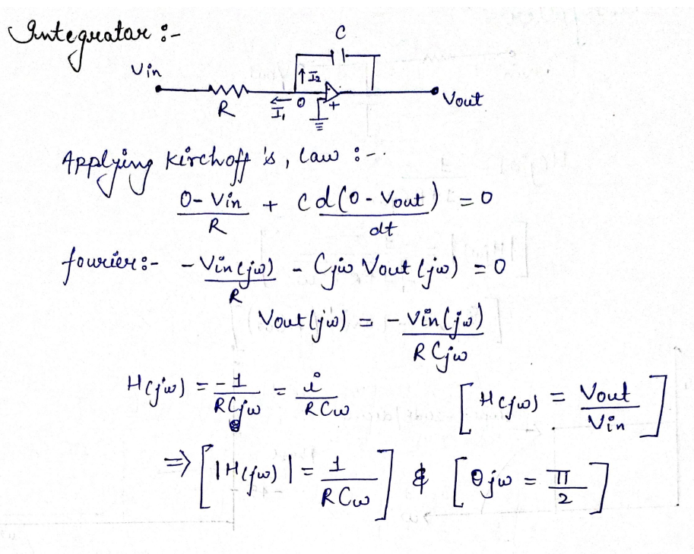
Explanation:

Slide 10
C. Demonstrate how the frequency response of the PID circuit resembles the behavior of lowpass, highpass, and bandpass filters. Note the range and nature of the passband frequency zone. Note the slope with which the response rises or falls from passband to stopband. Establish the relation between circuit components and the frequency response behavior's gain, phase, and slope.

Slide 11
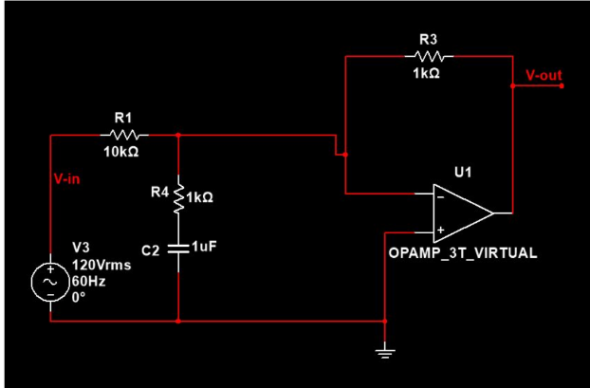
Low pass:

Slide 12
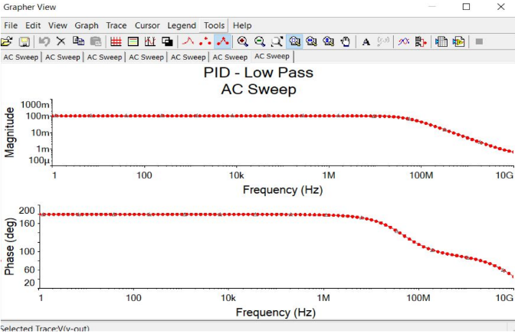
Graph:

Slide 13
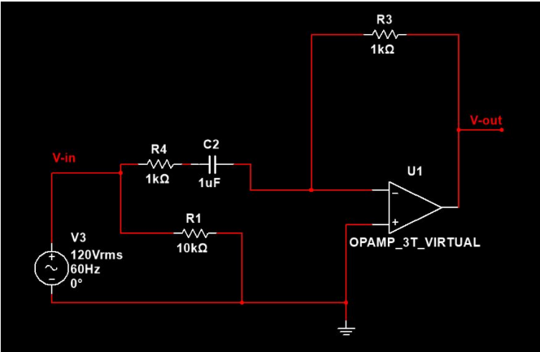
High Pass:

Slide 14
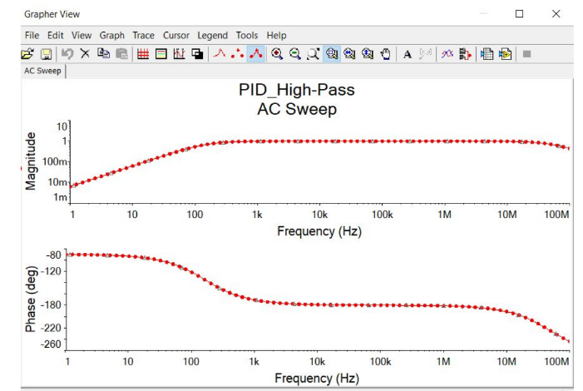
Graph:

Slide 15
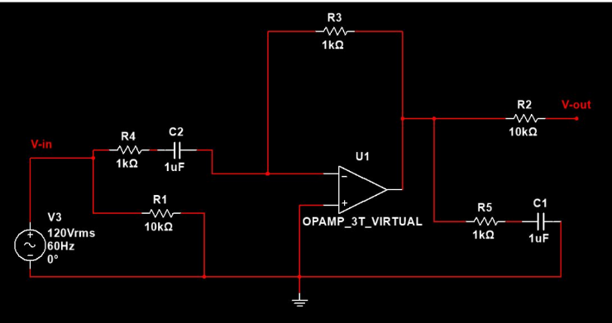
Bandpass:

Slide 16
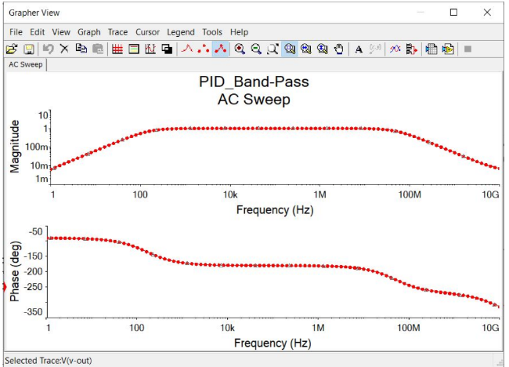
Graph:

Slide 17
D. Show how the generic frequency shaping filters can be designed for desired cutoff frequency and report the corresponding frequency domain characteristics. Study and explore first the theoretical design and then implement it by choosing the circuit components. You can try lowpass, highpass, and bandpass filters.

Slide 18
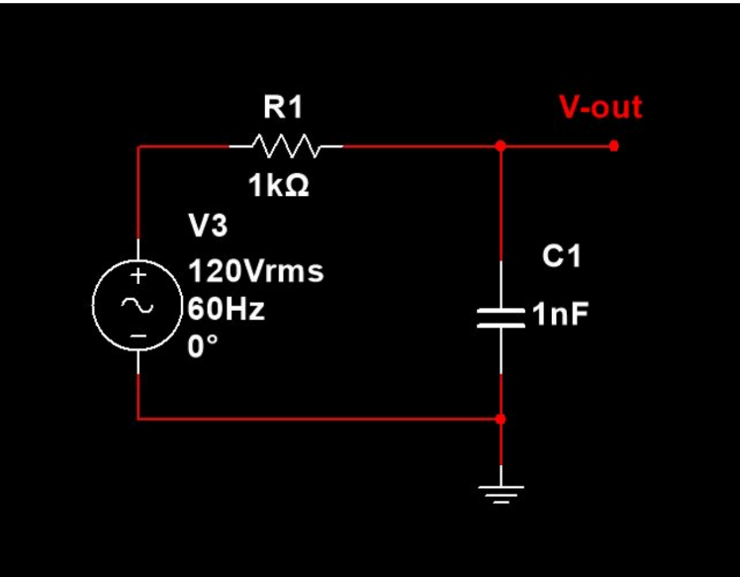
Circuit:

Slide 19
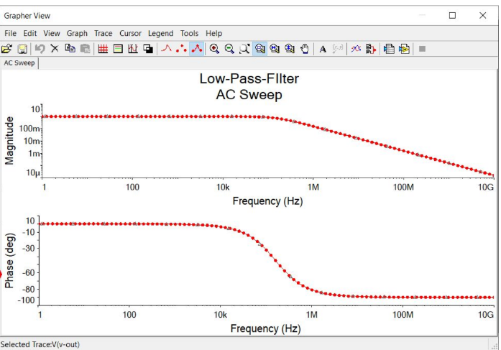
Graph:

Slide 20
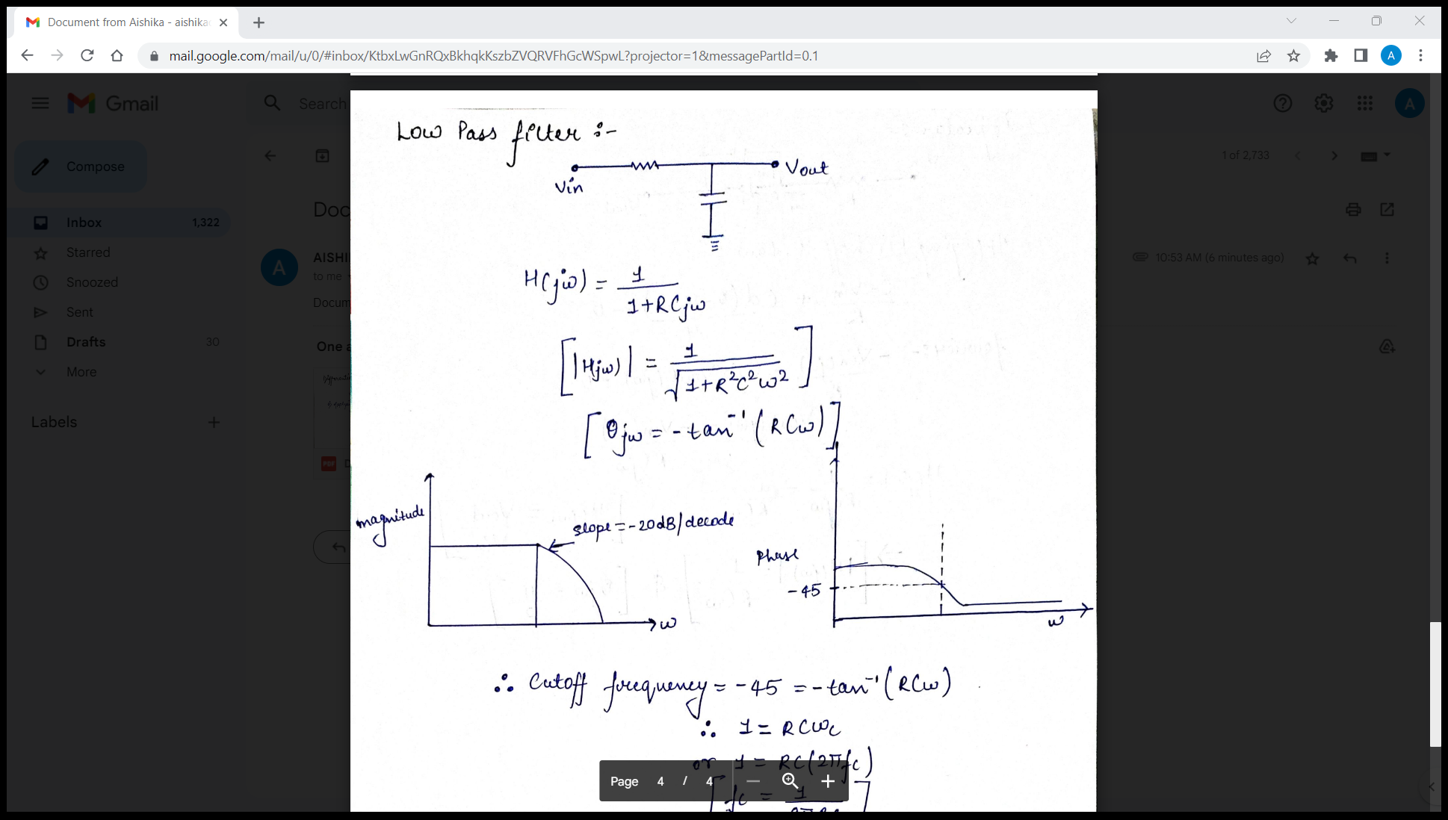
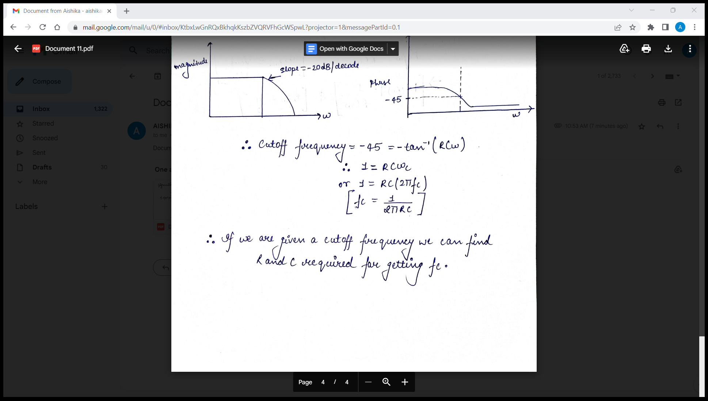
Explanation:

Slide 21
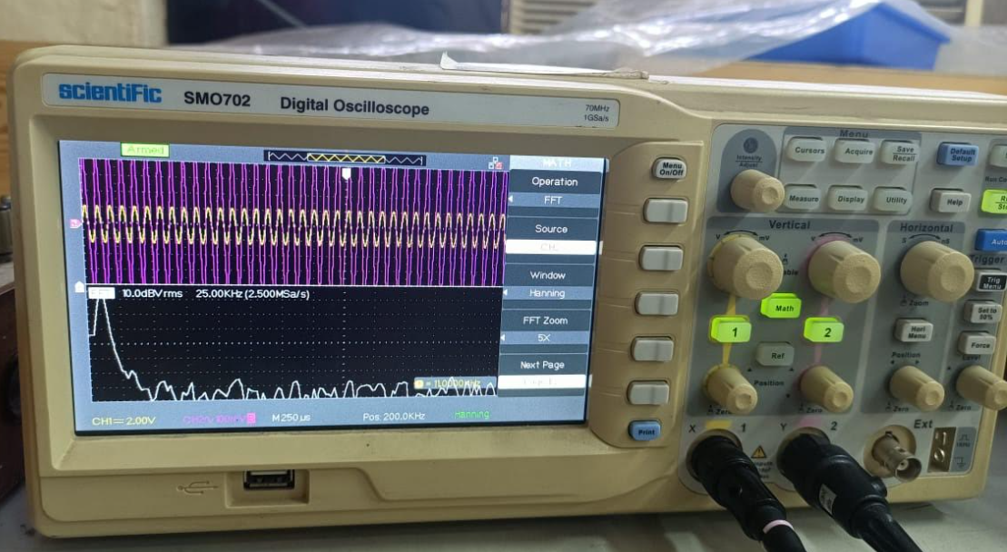
Output obtained:

Slide 22
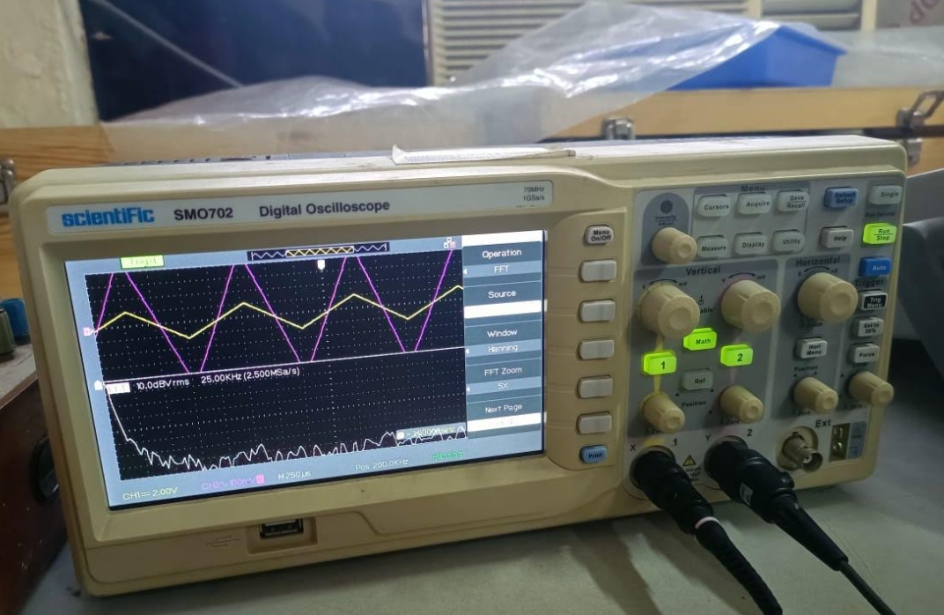

Slide 23
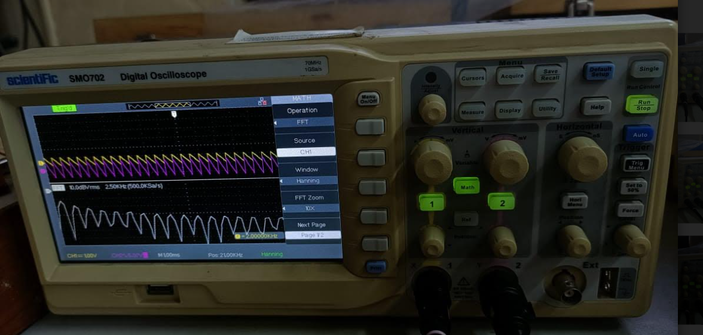

Slide 24
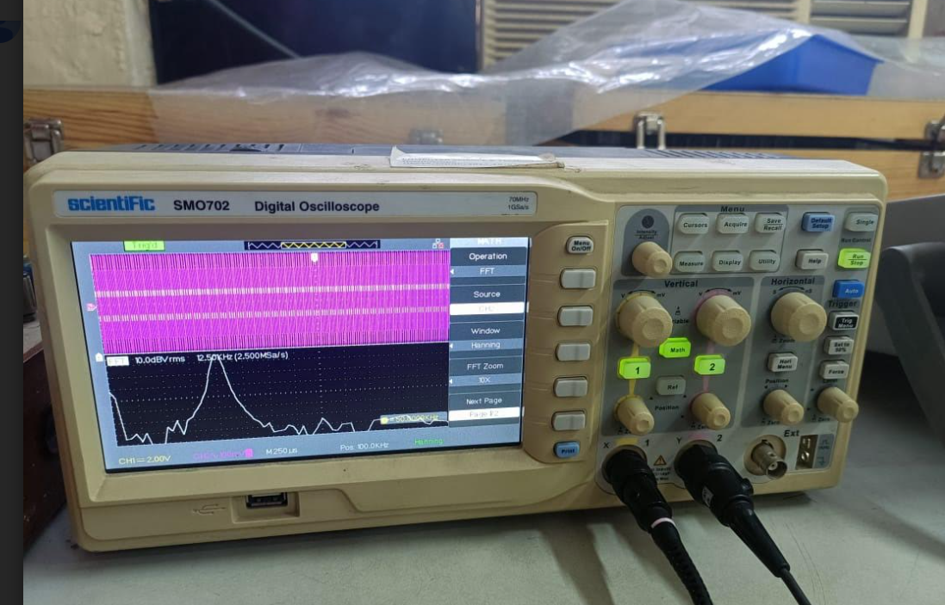

Slide 25
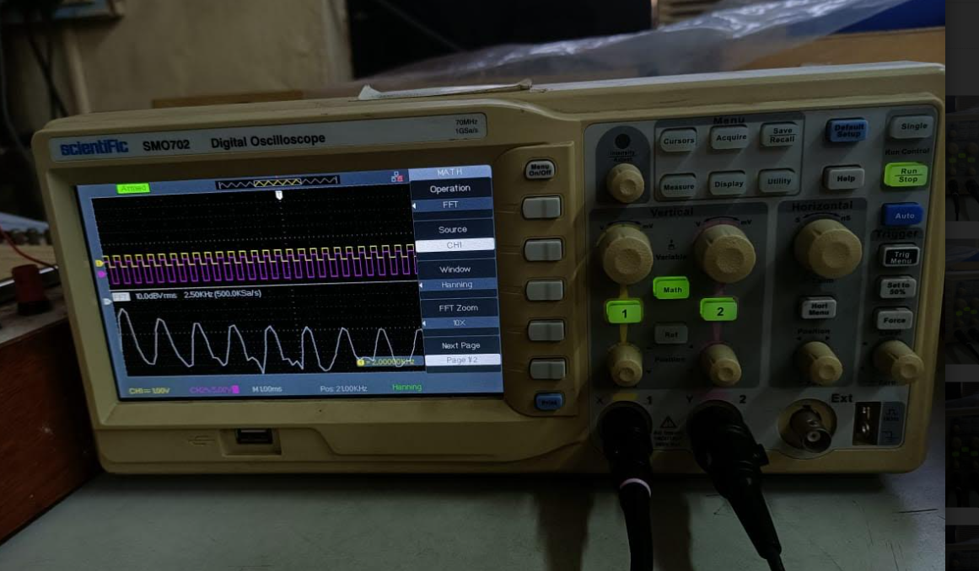

Slide 26
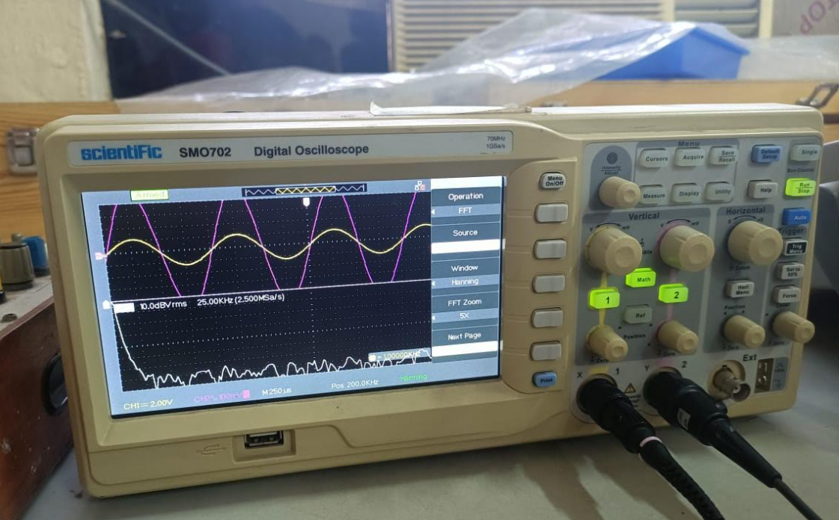

Slide 27
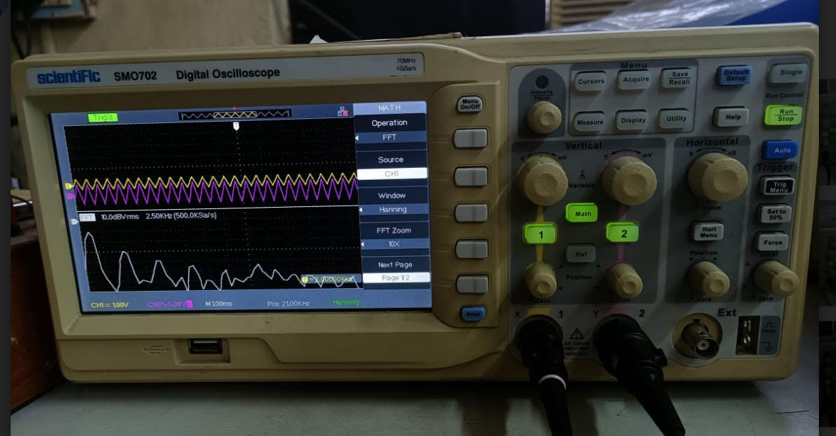

Slide 28
